Slide 1

Sprint 2
Henrik Vallestad
Jonny Hugøy
Peter Søreide Skaar
Ole Solem

Slide 2

General update

Slide 3

General update
Learning alot
Busy weeks.
Testing on seperate branches.
Focusing on different areas.

Slide 4
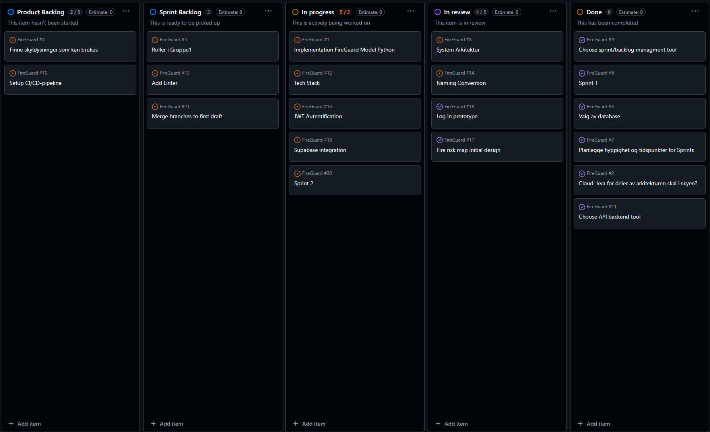
Kanban

Slide 5
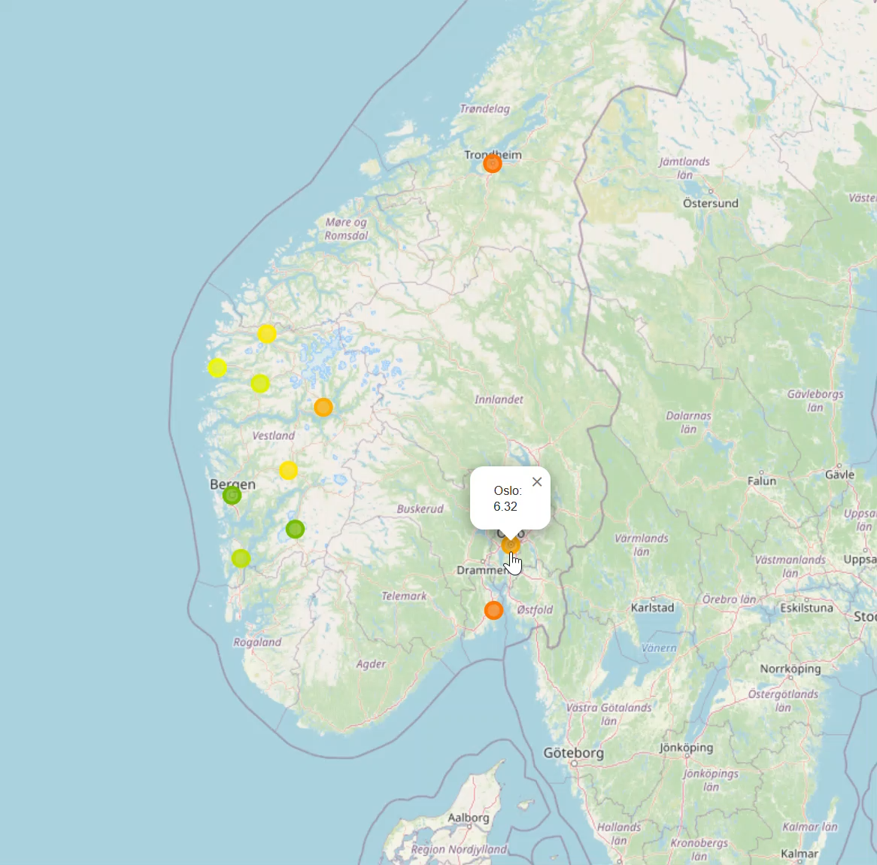
FrostMET to frontend
Gets data from the API
Next 20 days
Minimum value

Slide 6
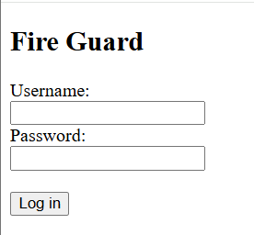
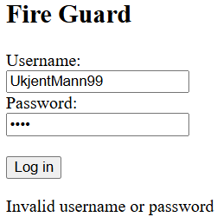
Authentification
Easy frontend
JWT
Connected to database

Slide 7


Supabase
Free to use
Alot of good autentification options
PostgreSQL
Host on docker private

Slide 8
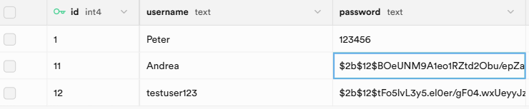
Supabase
Database to hold login information.
Encrypted passwords

Slide 9

Towards sprint 3
Linter as CI tool
Continue as we have with:
More focus on integration and testing
Merging testbranches to a first draft

Slide 10

The End?
Is this

